Slide 1
The Promise and Peril of SE Education in the Age of AI
Michael Hilton
Carnegie Mellon University
Notes:
AI, and particularly Large Language models have had a seismic impact on the world of Software Engineering. The world is still changing rapidly, and there are still more questions than answers about how the advent of LLMs will impact the world of Software Engineering Education. However, based on previous new technologies, and enduring SE principles, we can make some inferences about how things might go. In this talk we will discuss how we might want to think differently about SE Education in light of these recent changes, consider some of the implications of these new LLM based tools, and discuss how they will affect the students using them. The talk will discuss some concerns about these tools and how they have been influencing students, but also how they might be harnessed to improve SE Education.

Slide 2
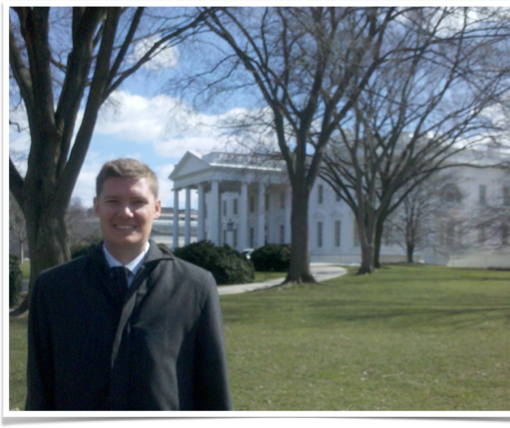


Introduction
A.S. Grossmont Community College
B.S. San Diego State University
Software Engineer at DoD
M.S. Cal Poly San Luis Obispo
PhD at Oregon State
Internship at Microsoft Research
Assistant/Associate/Full Teaching Professor at CMU

Slide 3
Ask:
Discuss “Integrating AI into Software Engineering Education” for the CSEE&T audience

Slide 4

Thanks to everyone who discussed with me
I appreciate the time many people took to talk with me
This is a rapidly changing world
Disclaimer: My expertise is in SE/Education, not in AI
Notes:
Would have generated a better (more diverse) picture, but was out of tokens… Resource limitation is a problem

Slide 5
Two Different Considerations
How should we teach: How can we effectively deliver Software Engineering education in a world where GenAI exists?
What should we teach: How should we think about educating student for a career in Software Engineering in a world where GenAI exists?
Notes:
What is the pedagogical impact of genai
What should we teach?
How should we teach?
Non realistic assessment
What could students do with google on an exam, more than without…

Slide 6
How can we effectively deliver Software Engineering education in a world where GenAI exists?

Slide 7

” Learning results from what the student does and thinks and only from what the student does and thinks. The teacher can advance learning only by influencing what the student does to learn” -Herb Simon
Turing Award 1975
Nobel in Econ 1978

Slide 8
Principle: AI will result in learning when it influences students to “do and think”

Slide 9
How are students using AI?

Slide 10
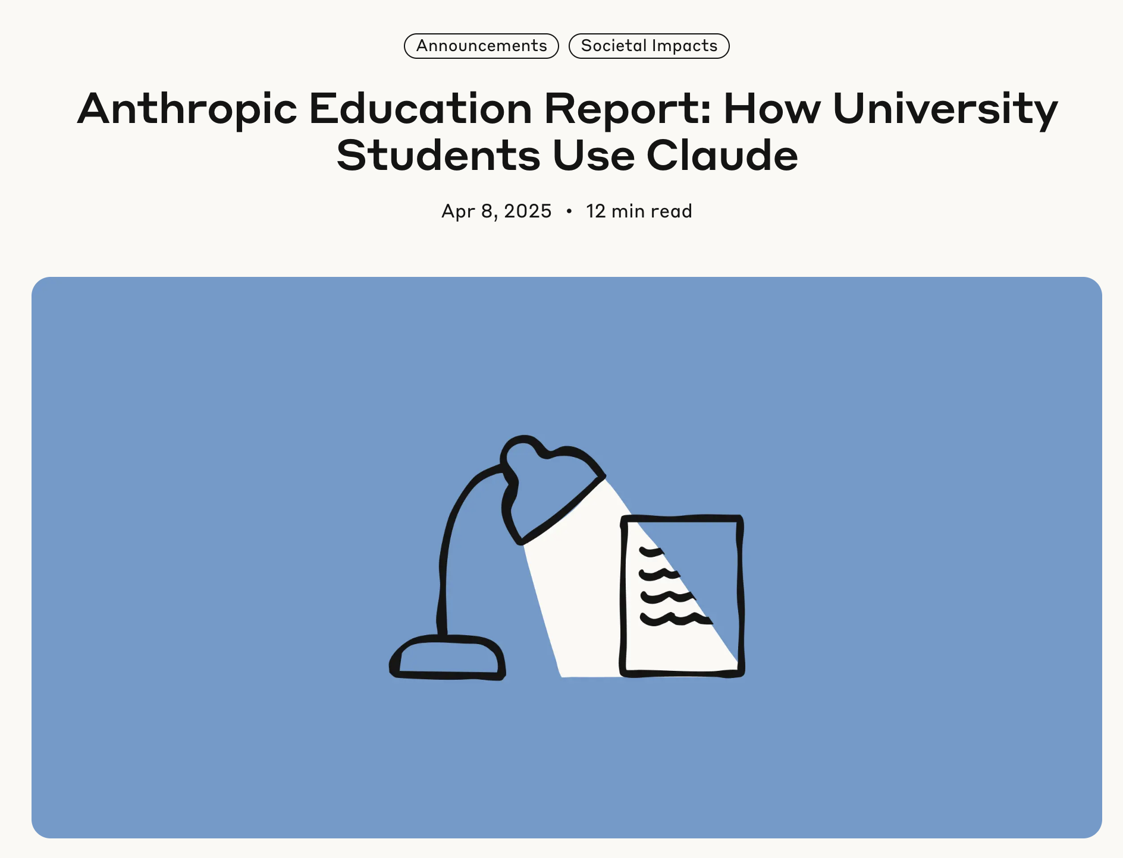
Report on student AI use
“one of the first large-scale studies of real-world AI usage patterns in higher education, analyzing one million anonymized student conversations on Claude.ai”
“Computer Science students particularly overrepresented (accounting for 36.8% of students’ conversations while comprising only 5.4% of U.S. degrees)”

Slide 11
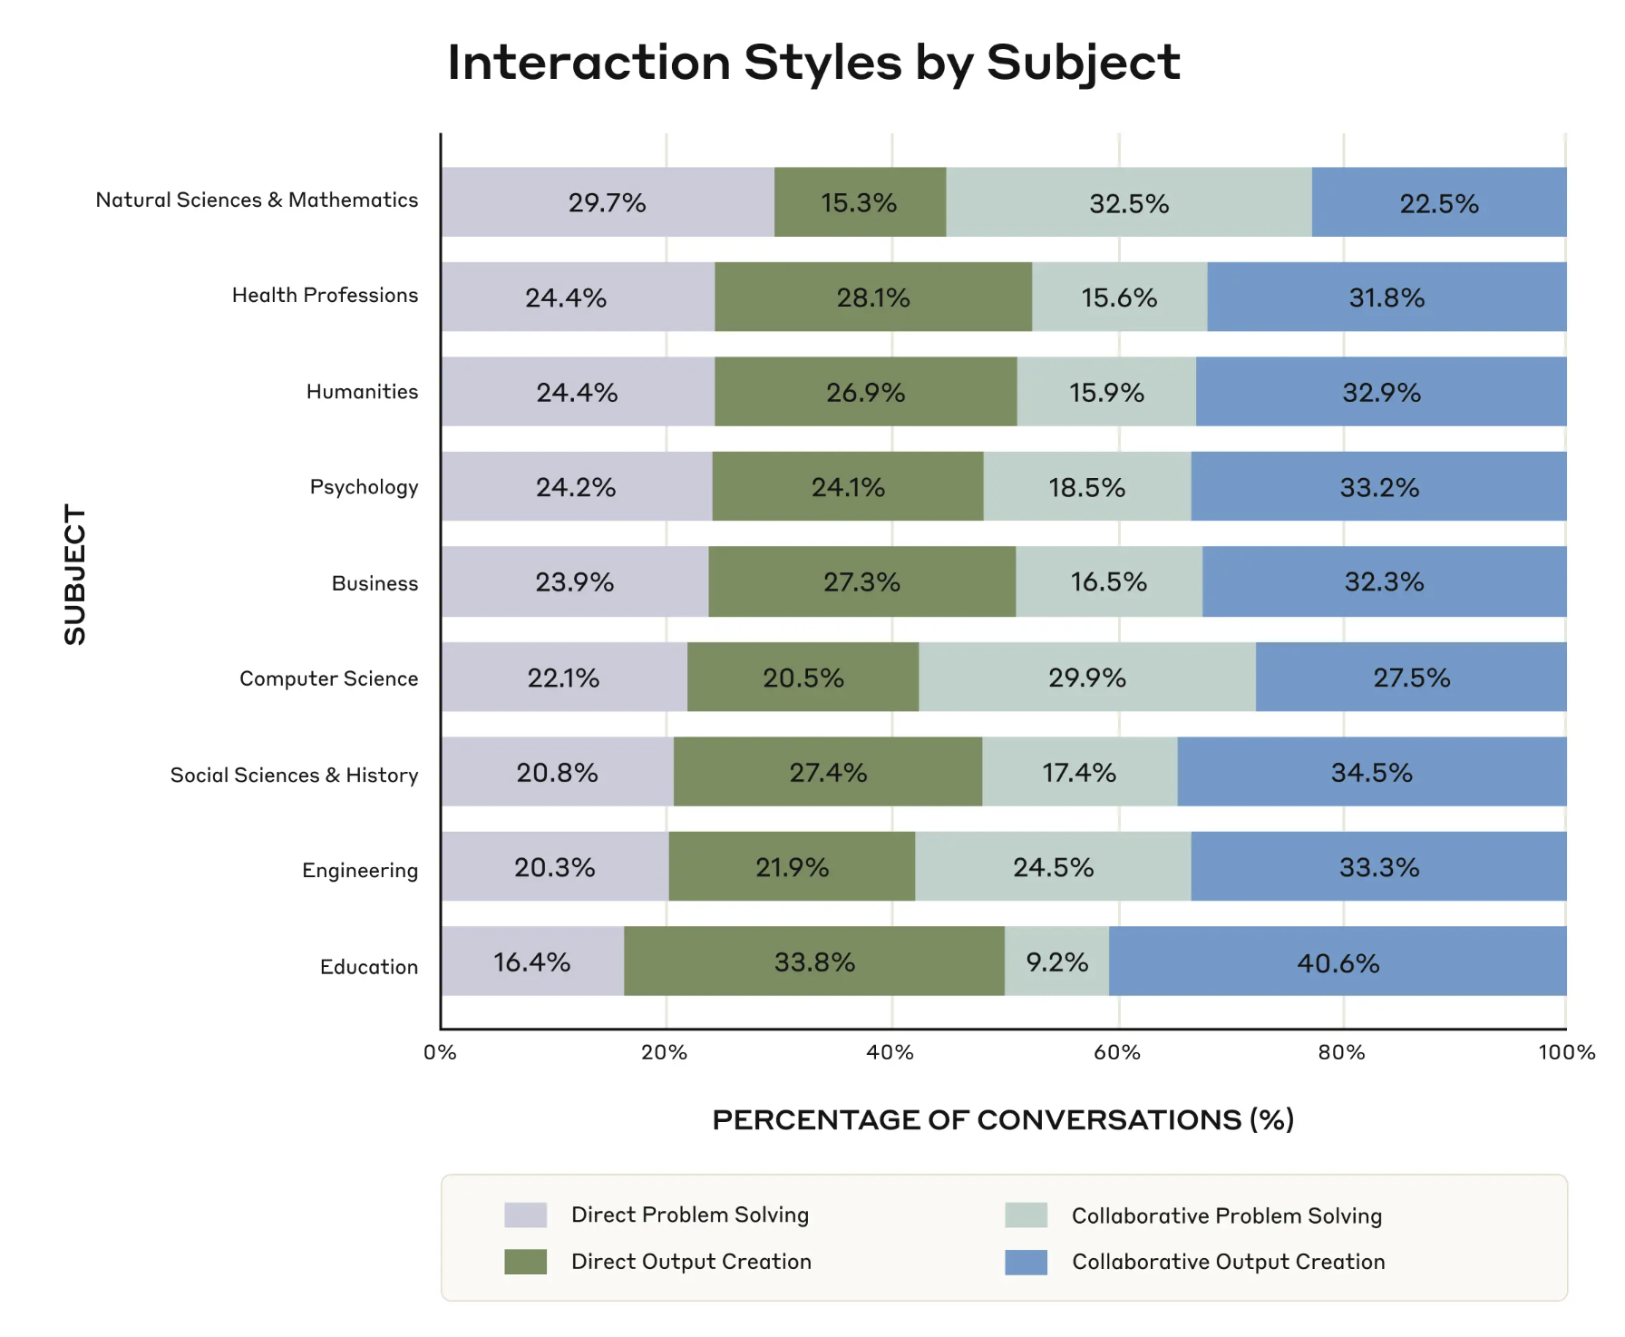
~50% of requests are Direct Problem Solving || Output Creation

Slide 12
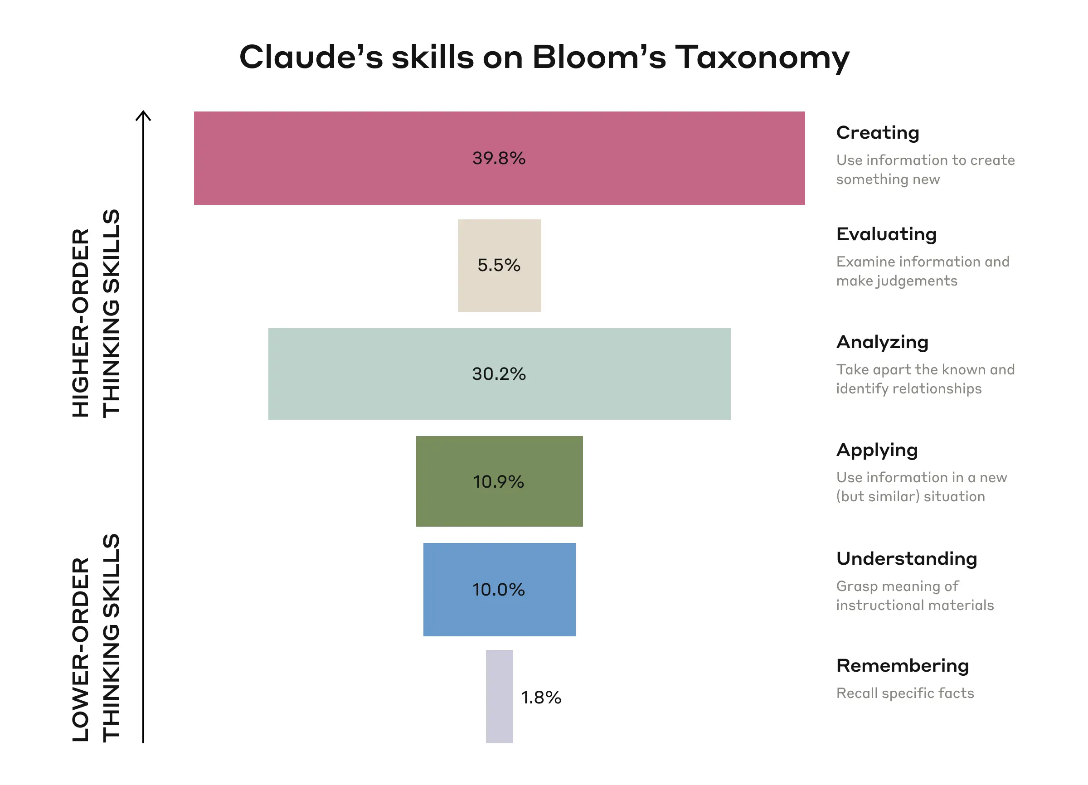
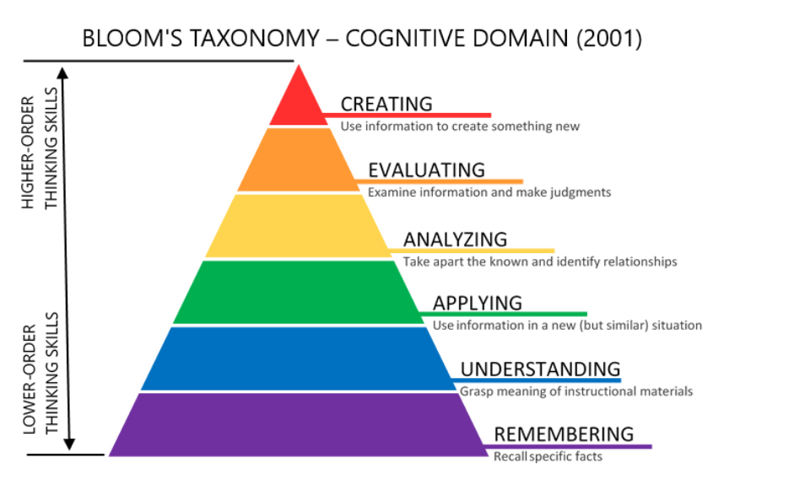
Cognitive tasks students delegate to AI
https://citt.ufl.edu/resources/the-learning-process/designing-the-learning-experience/blooms-taxonomy/

Slide 13
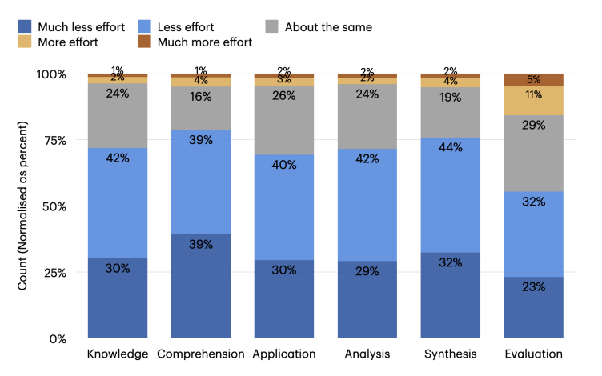
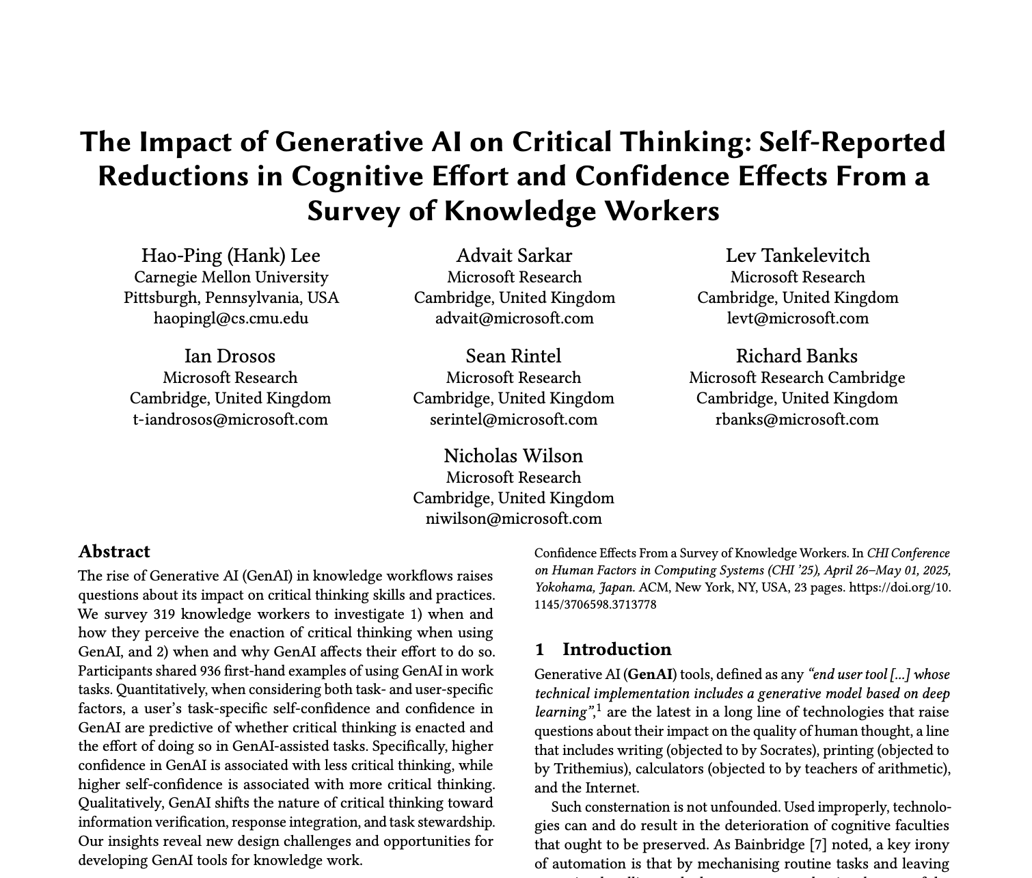
Similar effects observed in practice
Distribution of perceived effort (%) in cognitive activities (based on Bloom’s taxonomy) when using a GenAI tool compared to not using one.
Notes:
>300 surveys

Slide 14
Challenge: building component skills

Slide 15
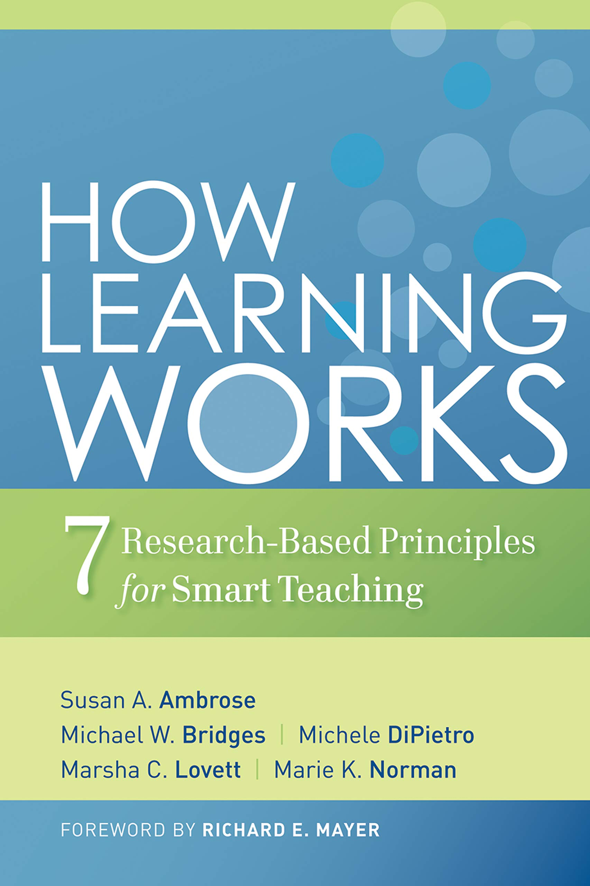
Developing Mastery
Principle: To develop mastery, students must acquire component skills, practice integrating them, and know when to apply what they have learned.
Ambrose, Susan A., et al. How Learning Works : Seven Research-Based Principles for Smart Teaching, John Wiley & Sons, Incorporated, 2010.

Slide 16

Component skills matter
Mastery
KNOW WHEN TO APPLY
Skills
“For students to achieve mastery within a domain, whether narrowly or broadly conceived, they need to develop a set of key component skills, practice them to the point where they can be combined ﬂuently and used with a fair degree of automaticity, and know when and where to apply them appropriately.”
PRACTICE
Integrating Skills
ACQUIRE Component skills

Slide 17
Example Component Skills
Research with introductory statistics students identiﬁed two key skills involved in statistical data analysis:
The ability to recognize the relevant variables
The ability to categorize them according to types.
45 minutes of direct instruction and feedback on identifying statistical problem types boosted beginners’ ability (Lovett 2002)
Consider a student writing a linked list. Component skills include:
Syntax
Abstraction of pointers
Abstract reasoning about data structure
…
We don’t need more linked lists in the world, but do students need to develop those skills?

Slide 18

Analogy: Calculators?
We teach match to people without using calculators, is that similar to using LLMs to program?
LLMs can program faster than a human
But calculators are always right. We don’t need to teach people to evaluate the output of a calculator
Similar analogy, compilers? Power tools?

Slide 19
What is hard about this?
UNCONSCIOUS
Competence
CONSCIOUS
Competence
1
2
3
4
CONSCIOUS Incompetence
UNCONSCIOUS Incompetence
Notes:
We are asking students to move through pain

Slide 20
Challenge: How do we motivate students to persevere in component skill learning?

Slide 21
Student motivation
Before LLMs:
Often motivated with Extrinsic Motivation (Grades)
More difficult to find answers (or easier to detect)
Often easiest path forward is to do the work
After LLMs:
Correct answers available with little to no effort
LLM answers are impossible to detect with high confidence
Easiest path forward is not doing the work

Slide 22
“People don’t care how much you know, till they know how much you care” -My Father

Slide 23
How do we get students to care?

Slide 24
Open question, IMHO key to good teaching
Suggestions:
Explain why component skills matter
Tie high level skills to long term goals
Provide authentic tasks when possible
Identify and reward what you value (be explicit about what you want students to do!)

Slide 25
What if we are causing students to think/do (aka learn) the wrong thing?

Slide 26
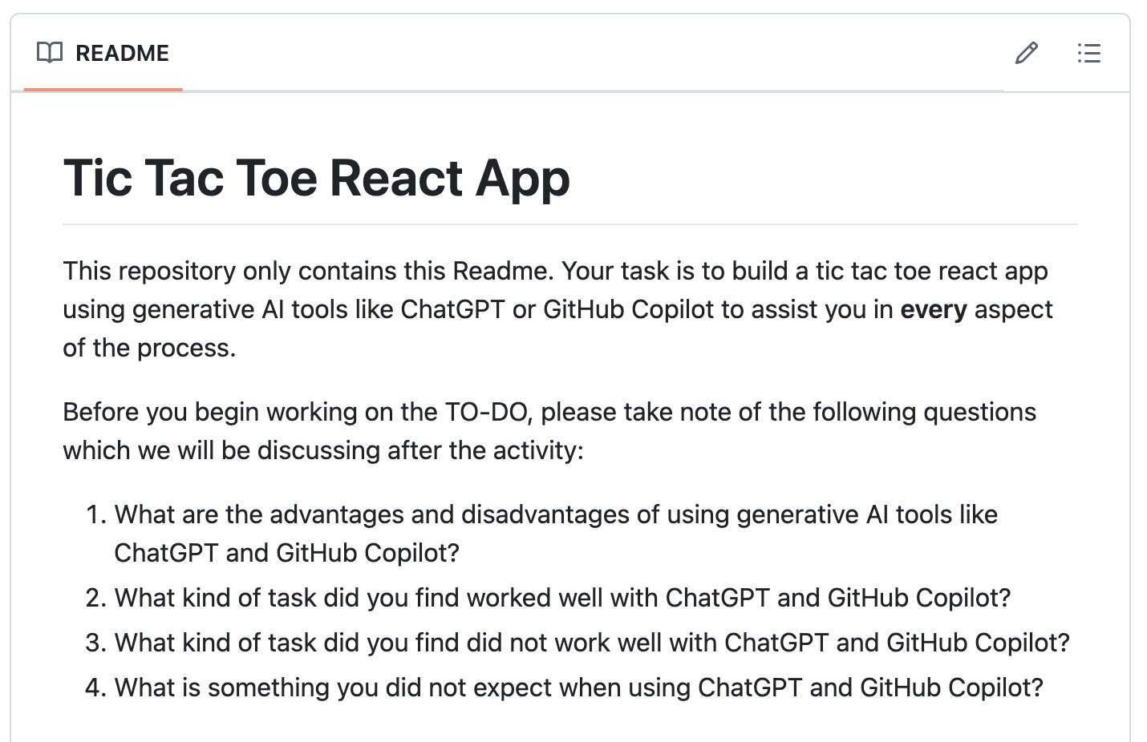
GenAI in-class experience
Apr 6, 2023
Wanted to experiment with GenAI Tools
Asked students to create a Tic Tac Toe React app
Class didn’t teach react
Ask them to not manually edit code (Vibe Code)

Slide 27
Experience
Students’ proficiency didn’t seem to correlate with their experience.
Did seem to correlate with demographic groups that we would expect to be high/lower self-efficacy
A student got bad code from AI, tried to follow the (incorrect) directions 6 times in a row, comment to me was “I can’t figure it out, I’m not sure what I’m doing wrong”
Another student said “programming with AI is like yelling at stupid person”

Slide 28
Follow up Experiences
In subsequent classes, instead of just asking students to try it out, I instead first demo the exercise, intentionally demonstrating the GenAI tool failing for me (while it is claiming to be correct)
Anecdotally, once I demonstrate this, I get very different answers from students
”It is also failing for me “ “The AI isn’t able to create the code I need”

Slide 29

This semester: Vibe Coding Exercise
Ask AI to answer explain feature in NodeBB (open source project), without code
Ask AI where to fix (without code)
Ask AI for patch (without providing code)
Ask AI for patch (with providing code)
Switch to Cursor/Windsurf (Context aware AI)
Repeat steps above
Asked students for their perceptions

Slide 30
This semester: Vibe Coding Exercise
Feedback:
“I’m probably going to use ai tools equally but be more cautious of their response.”
“told me to change a file that i can't find: src/controllers/post.js
“I feel like I am probably less likely to use AI unless I have very specific questions. It’s not very good at understanding and working on a complex codebase, and it’s just better for me to understand it myself.”
“The most time consuming thing about AI is double checking the work of AI since most of the time it may not be fully correct.”
“might use tools like cursor more (mainly just did chatgpt + copy/paste in past) but i also don’t want to drain my wallet with a billion subscriptions. also im not sure about the quality of the changes”
“In the future, I will continue to use AI tools, but I will be more careful on how much I use them, making sure to use them less”
“I think I will equally likely to use AI tools as before, I will continue to use it when getting stuck and just take it as suggestion instead of fully believe in it”

Slide 31
This semester: Vibe Coding Exercise
Feedback:
“I’m probably going to use ai tools equally but be more cautious of their response.”
“The most time consuming thing about AI is double checking the work of AI since most of the time it may not be fully correct.”
“might use tools like cursor more (mainly just did chatgpt + copy/paste in past) but i also don’t want to drain my wallet with a billion subscriptions. also im not sure about the quality of the changes”
“I think I will equally likely to use AI tools as before, I will continue to use it when getting stuck and just take it as suggestion instead of fully believe in it”

Slide 32
What does this matter?

Slide 33
Why Attribution matters?
Students who feel like they don’t belong will attribute mistakes to their not belonging. Students who do feel like they belong will attribute mistakes to the inherent challenge of the task.

Slide 34
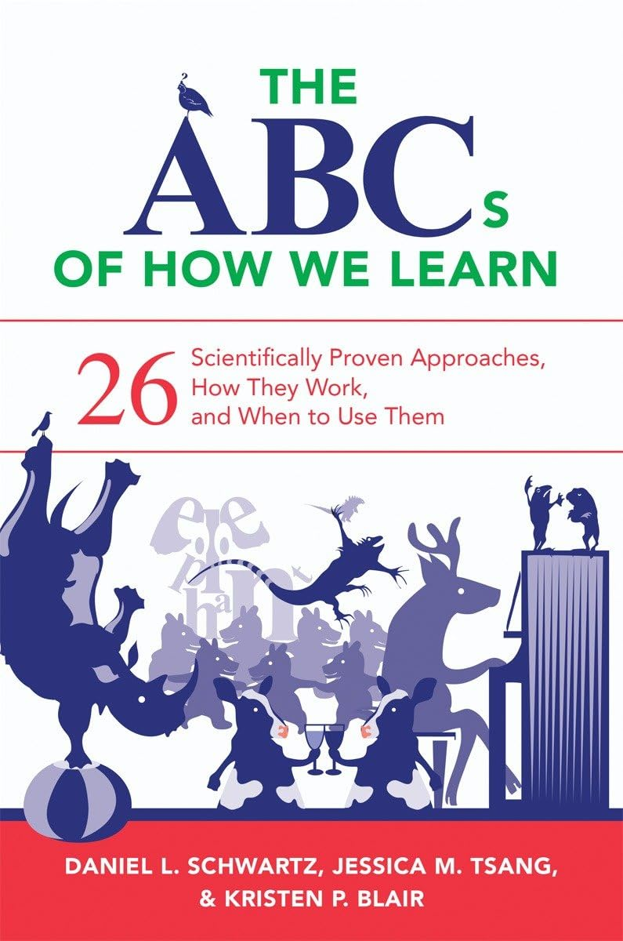
Changing Attribution
Changing Attribution can be a powerful tool.
“Walton and Cohen (2011) ... intervention particularly helped the African American students to reframe their interpretation of the daily adversities of being in college rather than seeing adversity as symbolizing that they do not belong, they reframed the setbacks as simply setbacks.”
Intervention didn’t help students who already felt they belonged
Notes:
Newspaper effect add slide

Slide 35
Positive use of GenAI in education

Slide 36

Requirements Engineering with GenAI
Before GenAI:
Students would interview humans as part of RE
Students would find subjects (often friend, relative, etc)
High cost in human time of subjects
Course staff didn’t have visibility into interviews
Subjects would often be overly agreeable, don’t really know what they need, talk in circles, etc
After GenAI:
Students practice interviews with GenAI agent before interviewing humans
Course staff has transcript of interview, can review, give feedback.
Low cost, students can repeat interviews till they achieve mastery
GenAI characteristics match human subject tendencies
https://arxiv.org/pdf/2503.07800

Slide 37
Principle:
AI will result in learning when it influences students to “do and think”
If students “do and think” more (e.g., do more practice interviews, get good feedback) they will learn more
Practice interviews should not replace human interviews, but can serve as simulator to help students practice at scale before interviewing humans.
https://arxiv.org/pdf/2503.07800
Notes:
An opportunity here to increase the scale

Slide 38
How should we think about educating student for a career in Software Engineering in a world where GenAI exists?

Slide 39
Will SE exist in 10 years?

Slide 40
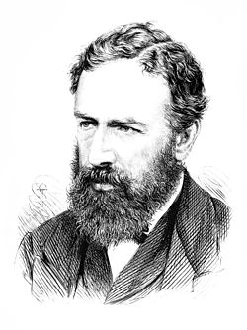
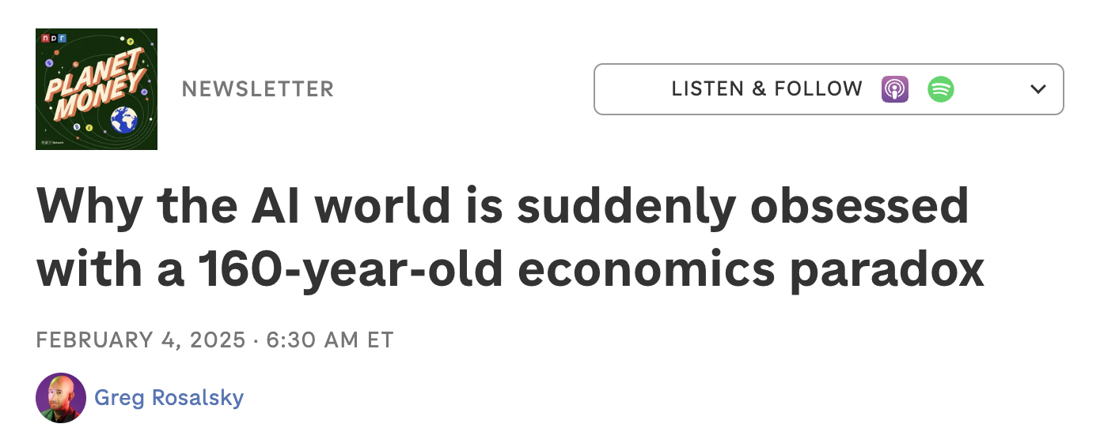
Jevons paradox
The Jevons Paradox describes a situation where technological advancements that improve the efficiency of resource use actually lead to increased overall consumption. This occurs because efficiency gains make the resource cheaper, which in turn stimulates increased demand and usage.

Slide 41
Maybe in 10 years, everyone will be a software developer?

Slide 42
Knoll’s law of media accuracy
“everything you read in the newspapers is absolutely true, except for the rare story of which you happen to have firsthand knowledge”

Slide 43

Should we teach students how to use GenAI?
Horses used to be essential transportation
Some people loved horses
Horses are no longer efficient for transportation, have been relegated to niche (and expensive) hobby
Zen coding used to be the way, but it is realistic it could be relegated to a hobby
Metcalfe corner of Sparks, 1895, Ottawa CA
Notes:
Chris pinged because he isn’t using AI enough

Slide 44
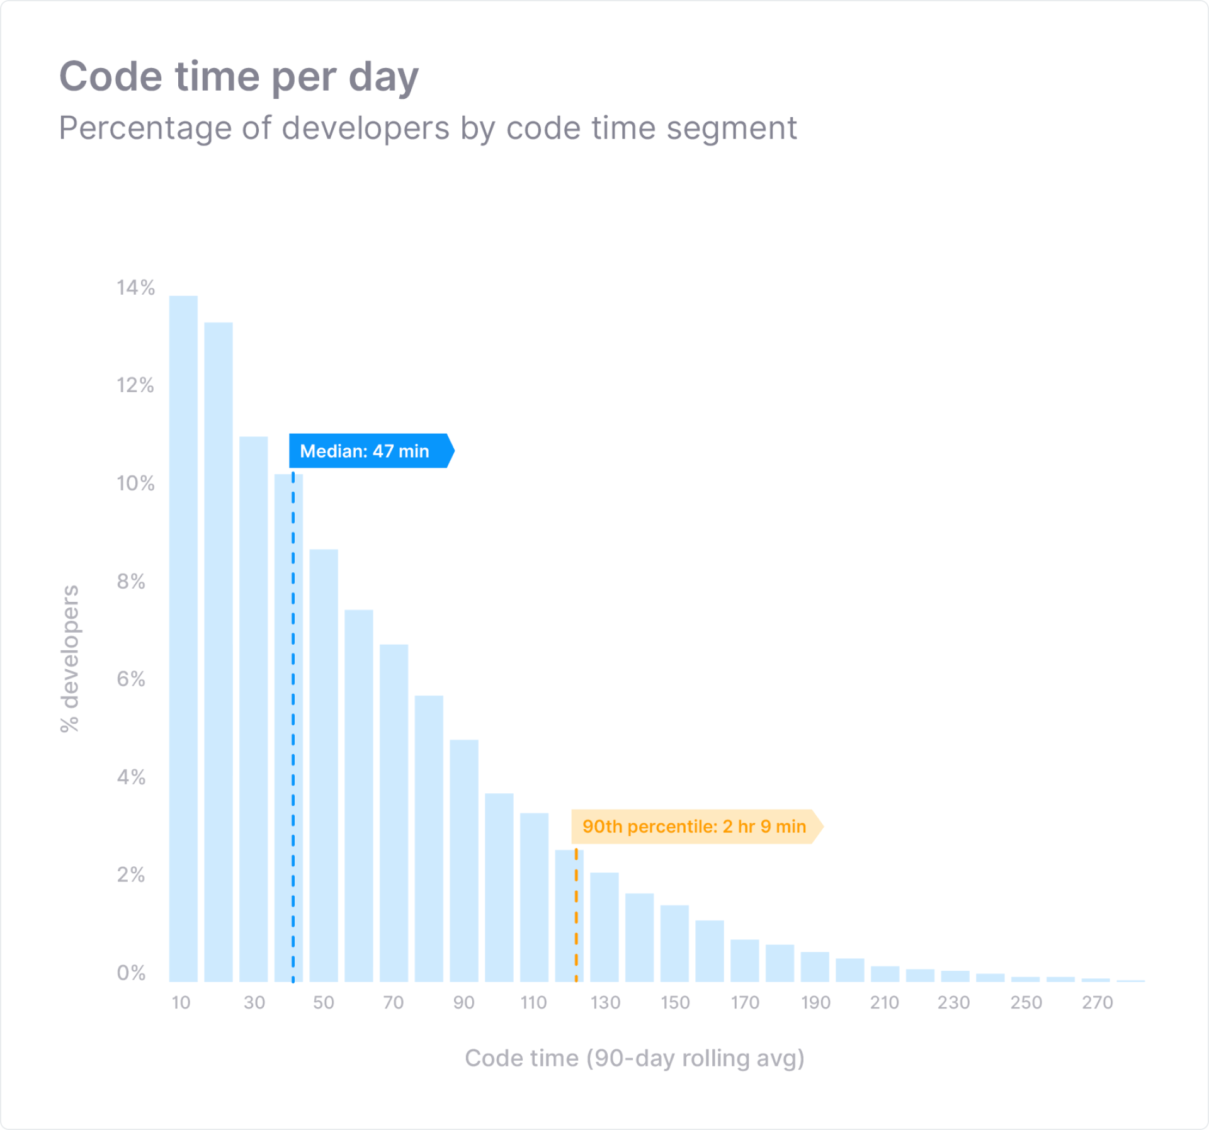
Most developers spend <1hr coding a day
Reminder: Software Engineering is a lot MORE than Programming
https://www.software.com/reports/code-time-report

Slide 45
So where do we go from here?

Slide 46
What would it look like to rethink SE education?
Should we teach reading before writing?
Should we teach ”judging” of AI as a separate skill?
What are the skills students will need to do SE in a world where code writing is “free”?
Should we focus on defining and identifying quality attributes such as readability, maintainability, etc?
How can we teach students validation and verification for code that they didn’t write?

Slide 47
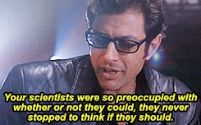
Jeff Goldblum Principle

Slide 48
Software Engineering should be about people building software for people

Slide 49
